Slide 1
Lockheed Martin Cyber Quest® 2023 King of Prussia Visitor Packet
®

Slide 2
Lockheed Martin Cyber Quest® 2023 King of Prussia Visitor Packet
Maps and directions are on the following charts
Buses may drop off, or park and wait. Bus drivers must remain with their vehicle at all times while on site.
It is recommended that team members and coaches arrive together.
Requirements for Entry into the Lockheed Martin Building
Only registered students and coaches will be admitted. No parents, siblings, or spectators. Alternates will only be admitted if they are replacing a primary team member, were pre-registered, and submitted a signed photo release.
For U.S. citizens, a government issued photo I.D. is required for anyone age 18 or older. School IDs are acceptable for students under 18.
For non-U.S. citizens of any age, a valid passport is required. Please do NOT forget to bring your passport to the event.
Competition Equipment and Rules
Each team is allowed to bring up to three (3) laptop computers to the competition. You may bring an external monitor, but table space is limited.
Keyboards & mice permitted if desired.
Reference books are permitted.
Printers, usb drives, & virtual machines are not permitted.
Students participating will have access to the Lockheed Martin Guest Wi-Fi, therefore internet access for research is permitted.
NOTE - Cell phones, digital watches, e-readers, and broadband network cards are NOT allowed during the Code Quest competition. If you are observed using any of these devices, your team is subject to immediate disqualification.
UNDER NO CIRCUMSTANCES are ANY phones or recording/photography devices allowed inside the facility. Please leave ALL phones in your cars. The following number can be given to family and friends in case of an emergency (610-531-5555).

Slide 3
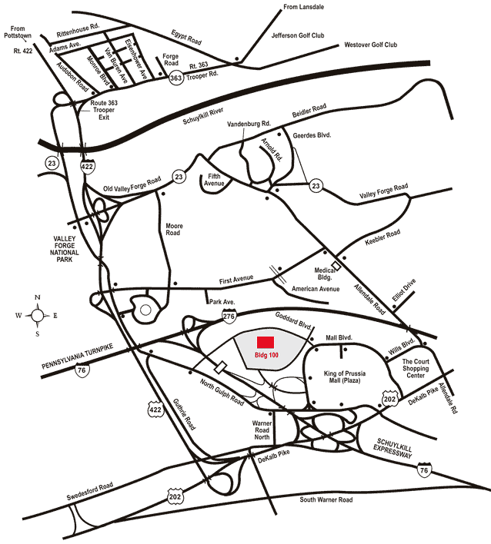
Lockheed Martin – Building 100 230 Mall Blvd, King of Prussia, PA 19406
Google Maps Link

Slide 4
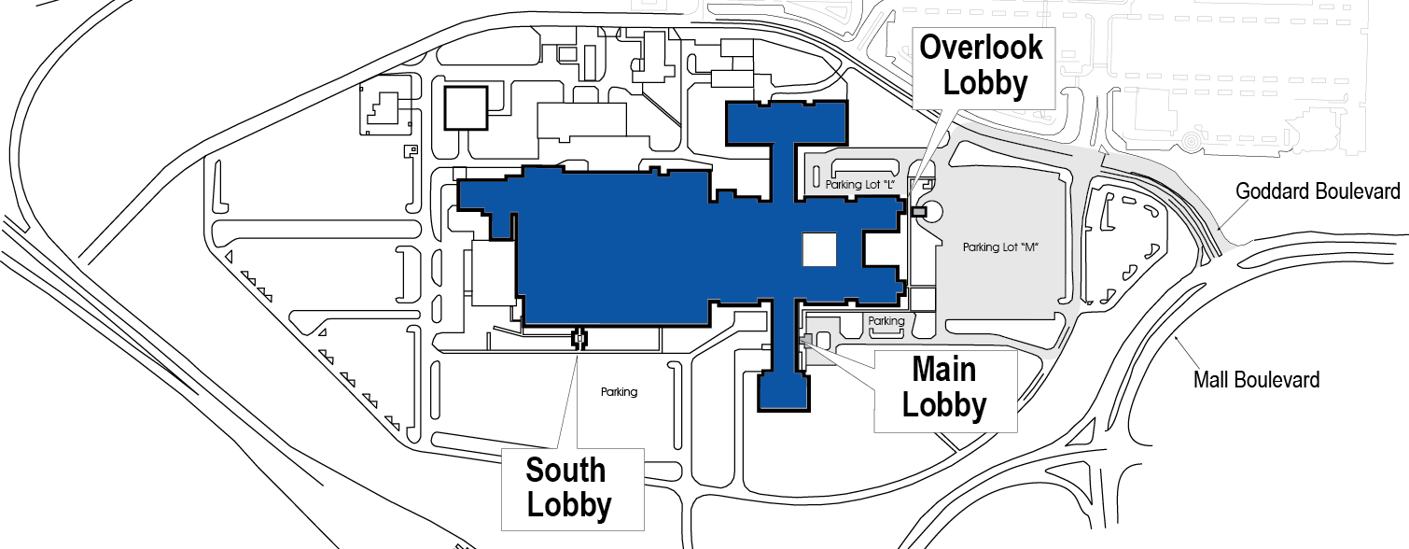
Lockheed Martin – Building 100 230 Mall Blvd, King of Prussia, PA 19406
Goddard Boulevard
Bus Parking
North Gulph Road
Cyber Quest® Participants
From Mall Blvd: Turn onto Goddard Blvd. Turn at the light at Conrad Dr. and make the first left into the Lockheed Martin Building 100 lot.
From North Gulph Road: Turn onto Goddard Blvd. Make the sixth right (Conrad Dr.) into the Lockheed Martin Building 100 lot. (third right is gated)
Cars: Park in Lot “M” and proceed to the Overlook Lobby entrance.
Busses: May drop off, or park and wait. Bus drivers must remain with their vehicle at all times while on site. Buses park in back of Lot “M”.

