Slide 1
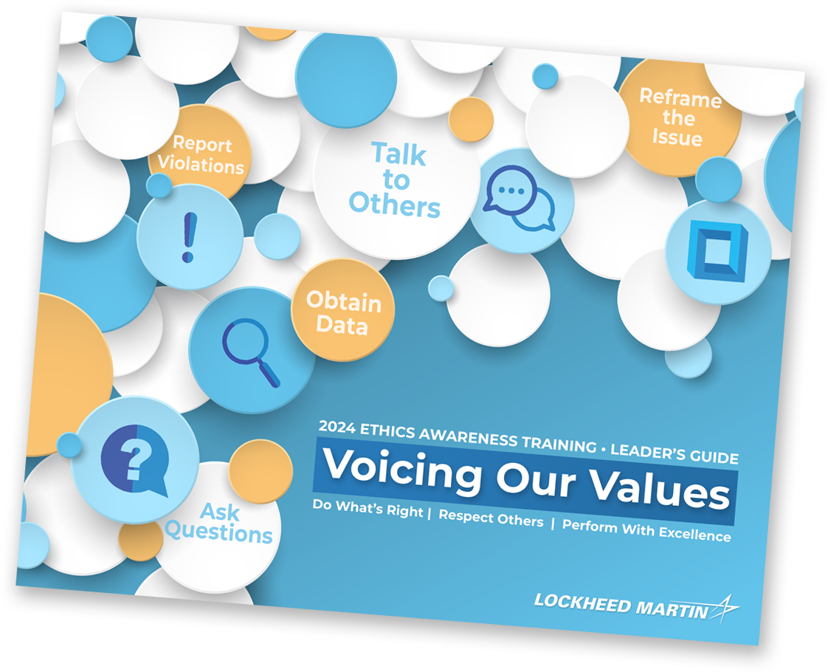
Case 4: Not My Model Faye uses open source software without following testing protocols. A surprise customer visit doesn’t go well.
Main Characters
Faye
Recent Hire; AI Expert
Jeff
Software Engineer
Ryan
Program Manager
Gabe
Customer

Slide 2
Case 4: Not My Model (Part One)
Main Characters
Faye
Recent Hire; AI Expert
Jeff
Software Engineer
Ryan
Program Manager
Gabe
Customer

Slide 3
Voicing Values Discussion
Summary
Faye uses open source software without following testing protocols. A surprise customer visit doesn’t go well.
Case 4: Not My Model Key Issues: Program Integrity, Ethics & Artificial Intelligence, Customer Relations, Gifts & Business Courtesies
Main Characters
What issues do these characters encounter?
Which Voicing Our Values (VOV) techniques could help resolve these issues?
Faye
Recent Hire; AI Expert
Jeff
Software Engineer
Ryan
Program Manager
Gabe
Customer
Ask Questions
Obtain Data
Talk to Others
Reframe the Issue
Report Violations

Slide 4
Case 4: Not My Model (Part Two)
Main Characters
Faye
Recent Hire; AI Expert
Jeff
Software Engineer
Ryan
Program Manager
Gabe
Customer

Slide 5
Wrap-up Discussion
Main Characters
How could this scenario end?
Bottom Line We can maintain our competitive edge while staying within the boundaries of our policies and protecting sensitive data and intellectual property.
Faye
Recent Hire; AI Expert
Jeff
Software Engineer
Ryan
Program Manager
Gabe
Customer
Ask Questions
Obtain Data
Talk to Others
Reframe the Issue
Report Violations

