Slide 1
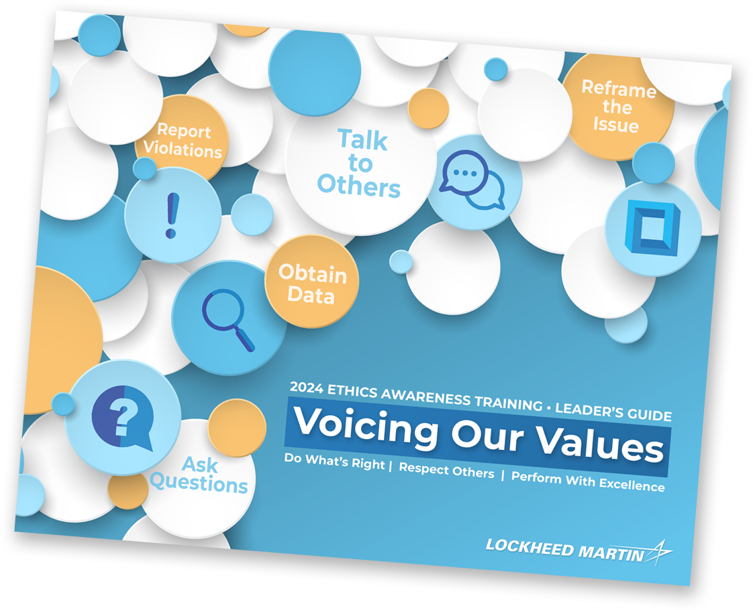
Case 6: It’s Relative Amy questions DIBCO’s compliance status. Edward and Joe are dismissive, but a crisis forces a closer look.
Main Characters
Amy
Software Engineer
Edward
Software Senior Manager
Richard
DIBCO CEO
Joe
Software Engineer
Michael
DIBCO IT Manager (Edward’s son)

Slide 2
Case 6: It’s Relative (Part One)
Main Characters
Amy
Software Engineer
Edward
Software Senior Manager
Richard
DIBCO CEO
Joe
Software Engineer
Michael
DIBCO IT Manager (Edward’s son)

Slide 3
Voicing Values Discussion
Summary
Amy questions DIBCO’s compliance status. Edward and Joe are dismissive, but a crisis forces a closer look.
Case 6: It’s Relative Key Issues: Cybersecurity, Leadership, Conflict of Interest
Main Characters
What issues do these characters encounter?
Which Voicing Our Values (VOV) techniques could help resolve these issues?
Amy
Software Engineer
Edward
Software Senior Manager
Richard
DIBCO CEO
Joe
Software Engineer
Michael
DIBCO IT Manager (Edward’s son)
Ask Questions
Obtain Data
Talk to Others
Reframe the Issue
Report Violations

Slide 4
Case 6: It’s Relative (Part Two)
Main Characters
Amy
Software Engineer
Edward
Software Senior Manager
Richard
DIBCO CEO
Joe
Software Engineer
Michael
DIBCO IT Manager (Edward’s son)

Slide 5
Wrap-up Discussion
Main Characters
How could this scenario end?
Bottom Line It’s important our transactions and relationships are free from even the appearance of impropriety. We are all responsible for protecting and safeguarding sensitive data and the integrity of our networks against unauthorized access.
Amy
Software Engineer
Edward
Software Senior Manager
Richard
DIBCO CEO
Joe
Software Engineer
Michael
DIBCO IT Manager (Edward’s son)
Ask Questions
Obtain Data
Talk to Others
Reframe the Issue
Report Violations

