Slide 1
Introduction Welcome to the 2025 Voicing Our Values Ethics Awareness Training. When ready, advance to the next slide to view the introduction video with Lockheed Martin Chairman, President and Chief Executive Officer, Jim Taiclet.

Slide 2
Voicing Our Values - Introduction

Slide 3
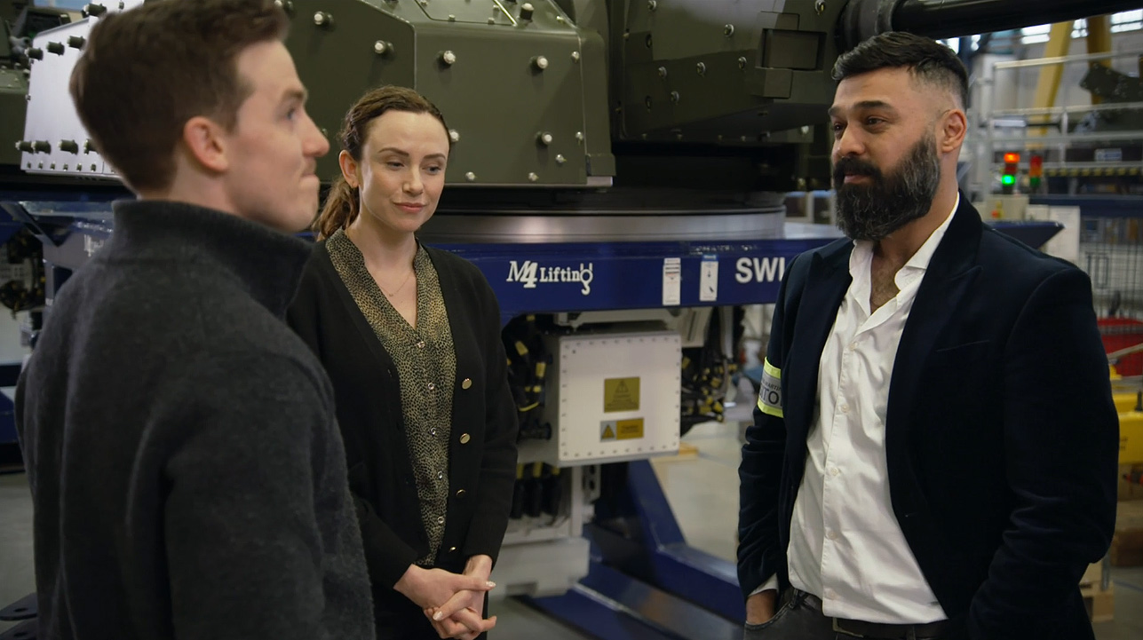
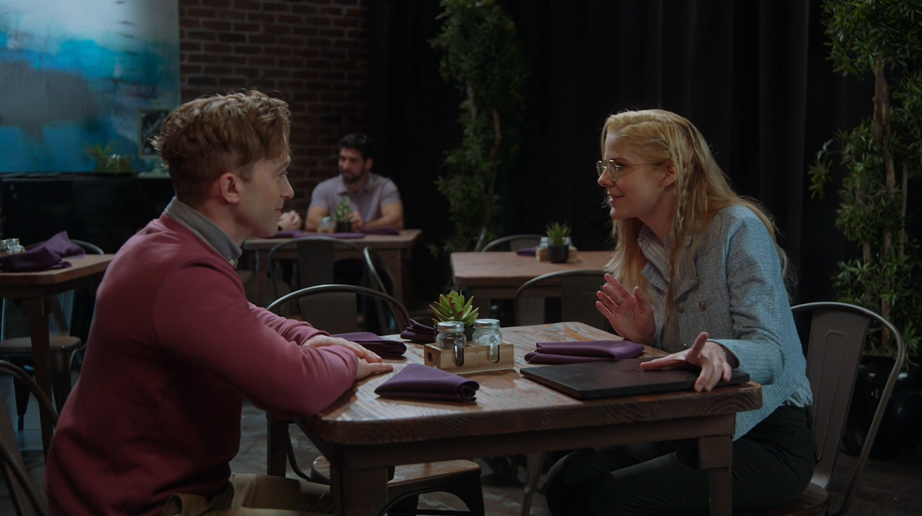
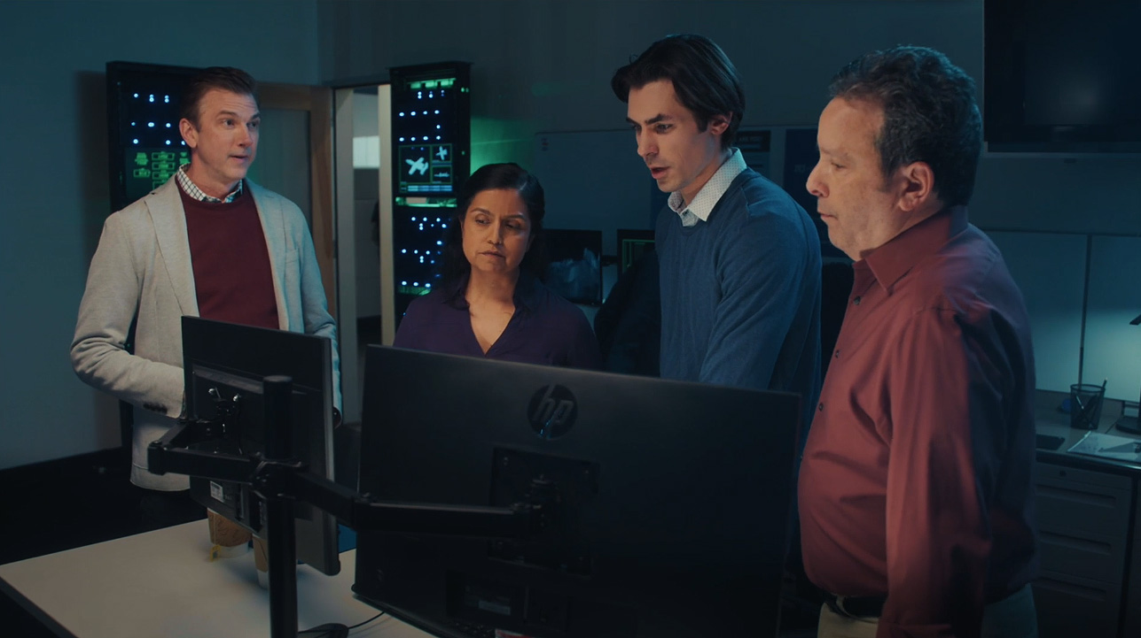
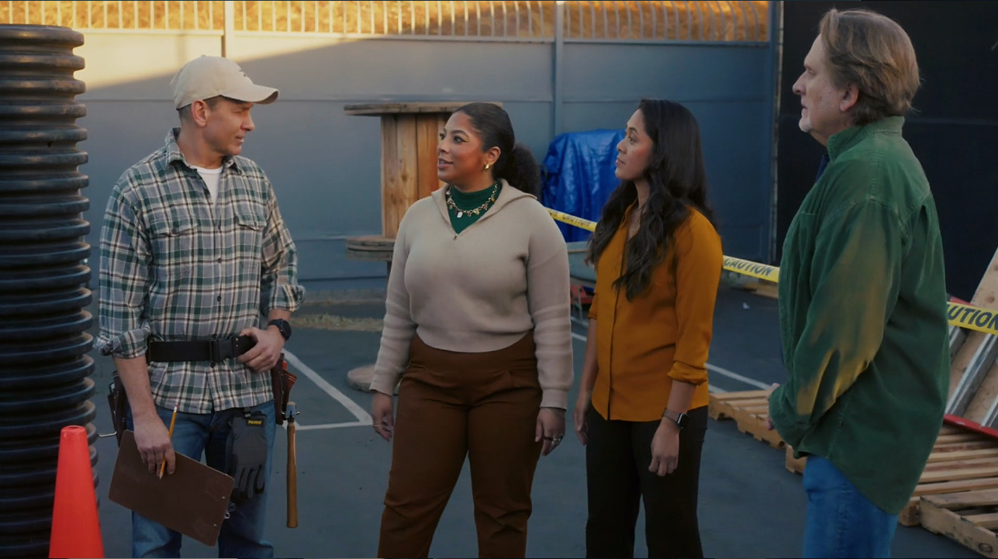
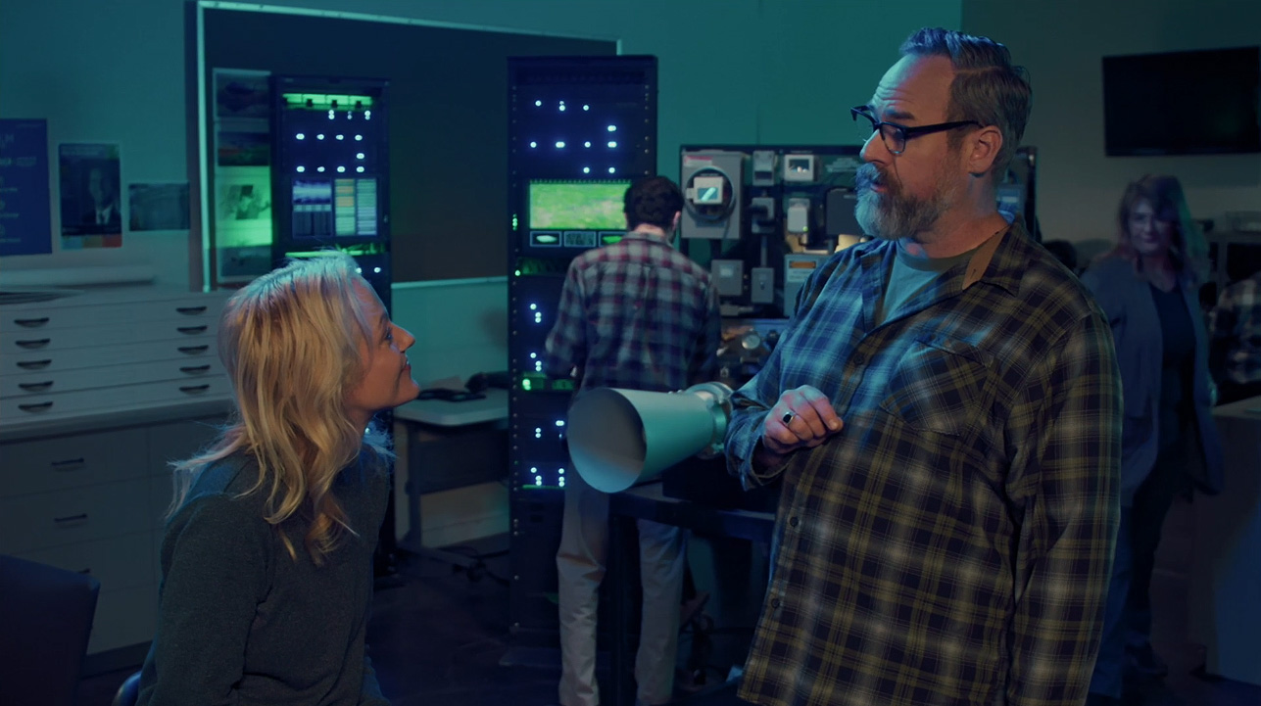
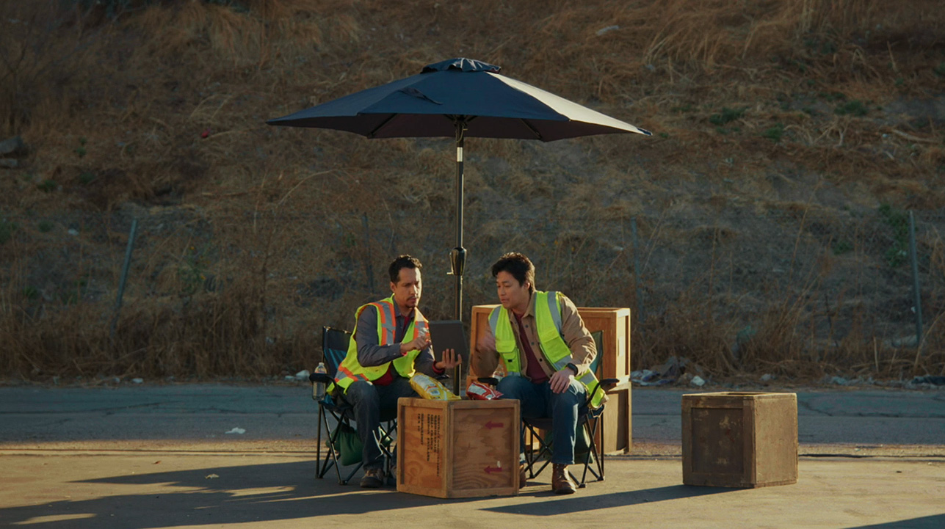
Voicing Our Values
You should now present and discuss the two or three cases that you’ve selected for your Ethics Awareness Training session.

